Slide 1

The Agentic Rolodex
Reinventing the contacts app for the AI age
Neha Senthil
Adil Gazder
Mobasserul Haque
Pranshul Bhatnagar

Slide 2
The Contacts app on your phone has never changed.

Slide 3
The Contacts app on your phone has never changed.
We’re here to change that.

Slide 4

The Problem We're Solving
Lost in the Noise
Tools That Don't Evolve
Professionals juggle hundreds of contacts across emails, LinkedIn, and calendars — but critical insights vanish in the chaos.
CRMs are built for sales teams, not people. Your phone's contact book? Still stuck in the 1990s.
Broken Relationships
The result: Missed opportunities. Forgotten follow-ups. Networks that fail to deliver value.

Slide 5

The Inspiration
From Rockefeller's Rolodex to AI Intelligence
In the early 1900s, John D. Rockefeller kept a legendary Rolodex filled with personal notes about everyone he met — from business partners to political figures. He understood that remembering details about families, deals, and interests wasn't just polite; it was powerful intelligence.
We asked ourselves: "What would Rockefeller's Rolodex look like in the AI era?"
The answer: A smart system that remembers, learns, and helps you nurture every connection with purpose.

Slide 6
Introducing The Agentic Rolodex
Your AI-powered networking assistant that transforms how you build and maintain professional relationships.
Enriches
Analyzes Conversations
Automatically structures your contacts with comprehensive context, pulling data from multiple sources to create rich, actionable profiles.
Uncovers key themes, sentiment patterns, and relationship dynamics from your interactions to reveal what truly matters.
Organizes
Delivers Insights
Intelligently suggests when and how to reconnect based on relationship strength, timing, and context — before you forget.
Makes every interaction more meaningful with predictive intelligence that understands relationship trajectory and opportunity.
It's not just a database — it's a relationship intelligence engine.

Slide 7

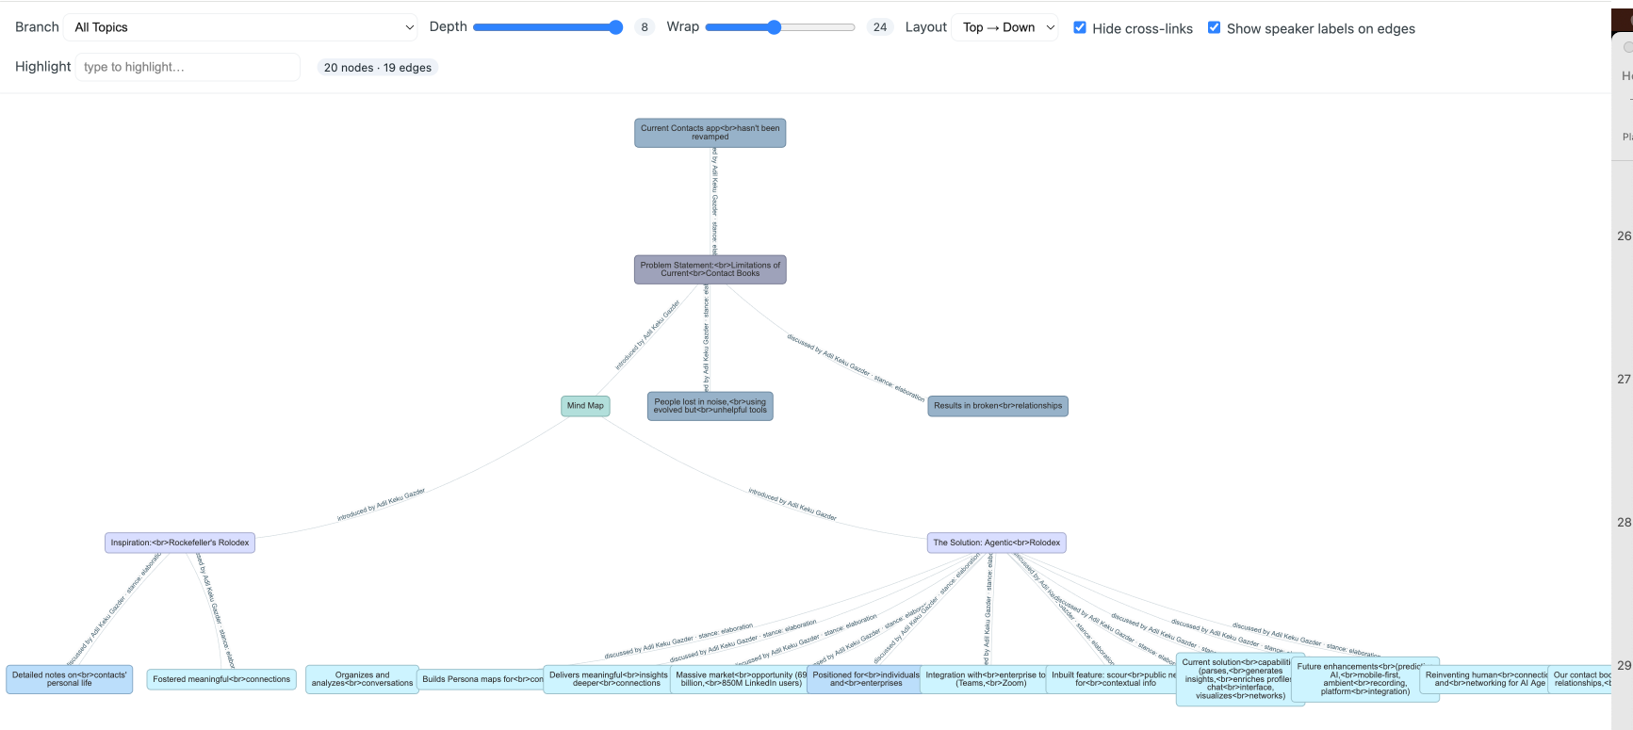


Conversation Recording
Ambient, Consensual
Supplemental Information
Scraped from the public web
John Doe
Contact Persona
Interaction based
Persona Chat
Visual MindMap
Retrospective view
User Interaction

Slide 8
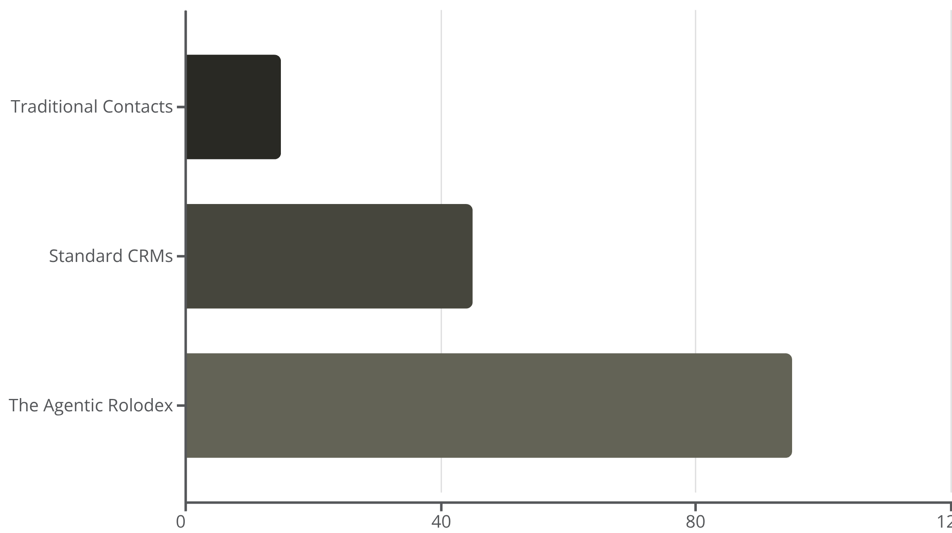
Our Competitive Edge
Manual updates, no insights, purely transactional interactions. A digital phonebook with zero intelligence.
Built for teams, not individuals. Complex setup, transactional mindset, and disconnected from personal networking needs.
Auto-enriched, contextual understanding, empathetic and predictive. Proactively strengthens relationships with AI-powered insights.
Productivity

Slide 9

Massive Market Opportunity
$69B
850M
4.5x
Global CRM Market
LinkedIn Users
AI Adoption Growth
Yet no tool focuses on personal relationship intelligence
Professionals actively managing networks without intelligent tools
Businesses embracing AI solutions at unprecedented rates
With AI adoption surging, the next frontier isn't managing data — it's managing human connection intelligently. We're positioning The Agentic Rolodex as the go-to platform for modern networking.

Slide 10

Our Progress: Built & Proven
We've built a working prototype that demonstrates the core capabilities of intelligent relationship management:
Parse & Analyze Conversations
Real-time analysis of communication patterns and content extraction from multiple channels.
Generate Relationship Insights
AI-driven analysis reveals connection strength, communication frequency, and engagement quality.
Auto-Enrich Profiles
Seamless integration with public data sources to maintain comprehensive, current contact information.
Visualize Networks
Interactive visualization of connection strength and untapped opportunities within your network.

Slide 11




The path ahead
Platform Integration
Predictive AI Enhancement
Mobile-First Experience
Seamless connection with Gmail, LinkedIn, Slack, and other major communication platforms.
Advanced personalization engine that learns your networking style and predicts relationship opportunities.
Intuitive mobile application designed for on-the-go relationship management and instant insights.

Slide 12

The Vision
Just as Rockefeller's Rolodex helped him understand people deeply, The Agentic Rolodex empowers modern professionals to do the same — with AI as their silent partner.
We're not just digitizing contacts.
We're reinventing human connection for the AI age.

Slide 13
Your contact book remembers names.
Ours remembers relationships.

Slide 14




Pranshul Bhatnagar
MIDS ‘27
Duke University
Neha Senthil
MSCS ‘25
Duke University
Mobasserul Haque
MIDS ‘26
Duke University
Adil K Gazder
MIDS ‘26
Duke University

Slide 15
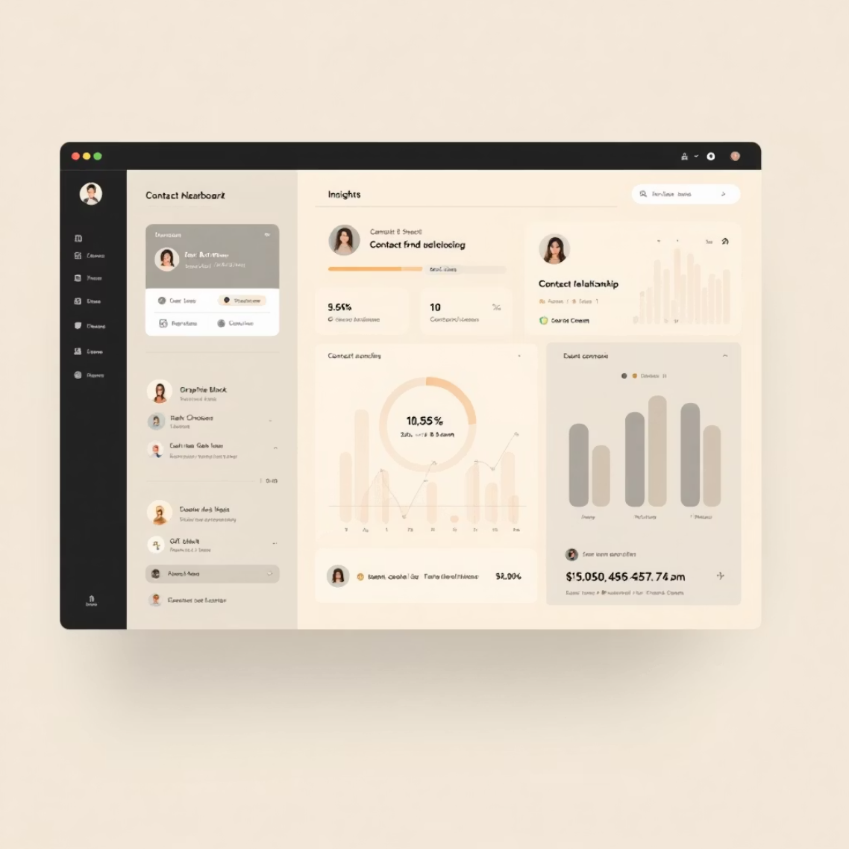
How It Works
01
AI + NLP Understanding
Advanced natural language processing understands context from messages, notes, and calls — extracting meaning beyond keywords.
02
Vector Memory Storage
Stores contact embeddings for semantic search, enabling you to find connections based on meaning, not just metadata.
03
Automated Enrichment
Continuously aggregates public data from LinkedIn, websites, and calendars to keep profiles current and comprehensive.
04
Proactive Action Engine
Suggests who to reach out to and why — intelligently prioritizing relationships that need attention or present opportunities.

